Slide 1
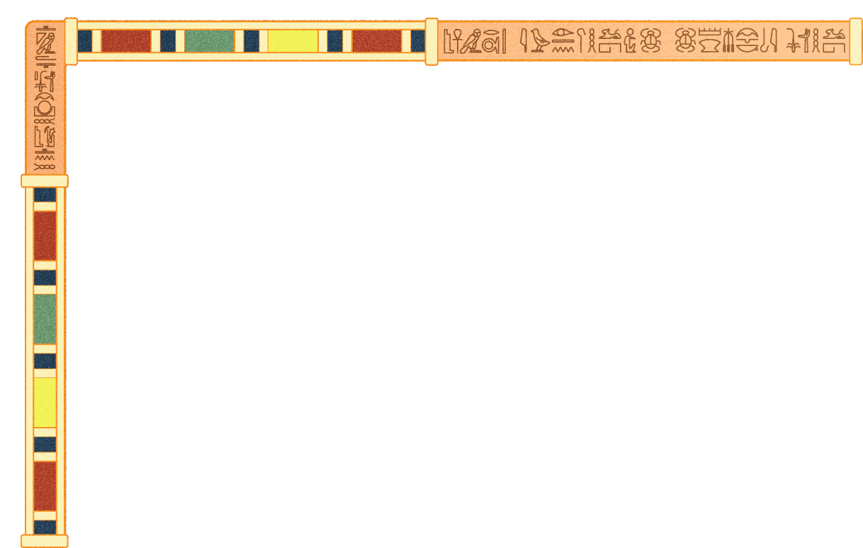

Identifying the Hieroglyphic language in Ancient Egyptian Manuscripts
Information Systems Department
Faculty of Computer and Information Sciences
Ain Shams University
Unlocking Ancient Secrets

Slide 2
SUPERVISED BY
Dr : Mona Abdelazim
TA : Mohamed Essam

Slide 3
Team Members
Mohamed Ashraf Sayed Hussein
Mohamed Ehab Fathy Zahran
Mustafa Hosny Mohamed El-Sayed
Salma Adel Shahin Omar
Salma Hossam Ahmed Abdo
Seif El-Din Hesham Mohamed

Slide 4
AGENDA
INTRODUCTION
System Architecture
01
02
Datasets
Models
03
04
Results
06
Related Works
05
List of Functions
Software Tools
07
08
09
Demo
10
Future Work

Slide 5
01
INTRODUCTION

Slide 6
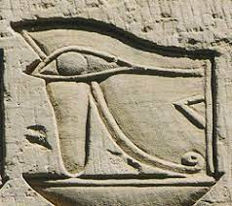
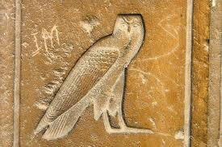
What are Hieroglyphics?
Hieroglyphics is a writing system used in ancient Egypt. It is called "sacred writing" in Greek.
Hieroglyphs comprise a system of “picture-writing” in which the “letters” are images.
Eye Owl
There are around 1000 hieroglyphic symbols.

Slide 7
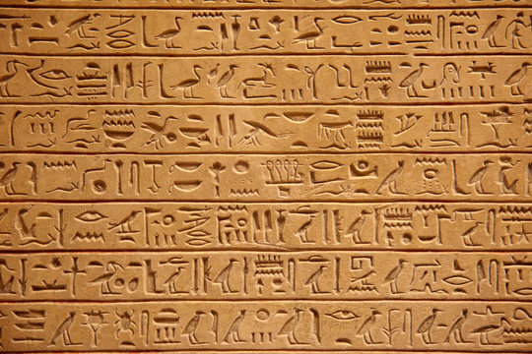
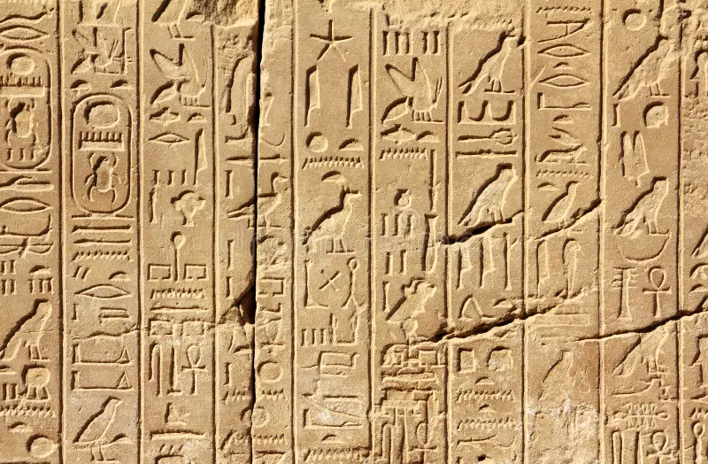
What are Hieroglyphics?
Lines of hieroglyphic writing can be written in rows left to right, right to left, or in columns from top to bottom.
Rows (left to right OR right to left)
columns (top to bottom)

Slide 8
Problem Definition
Hieroglyphic language, known for its complexity.
Hieroglyphic translation traditionally limited to experts.
Barriers prevent the general public, especially tourists, from understanding and appreciating ancient Egyptian culture.

Slide 9
02
SYSTEM ARCHITECTURE

Slide 10
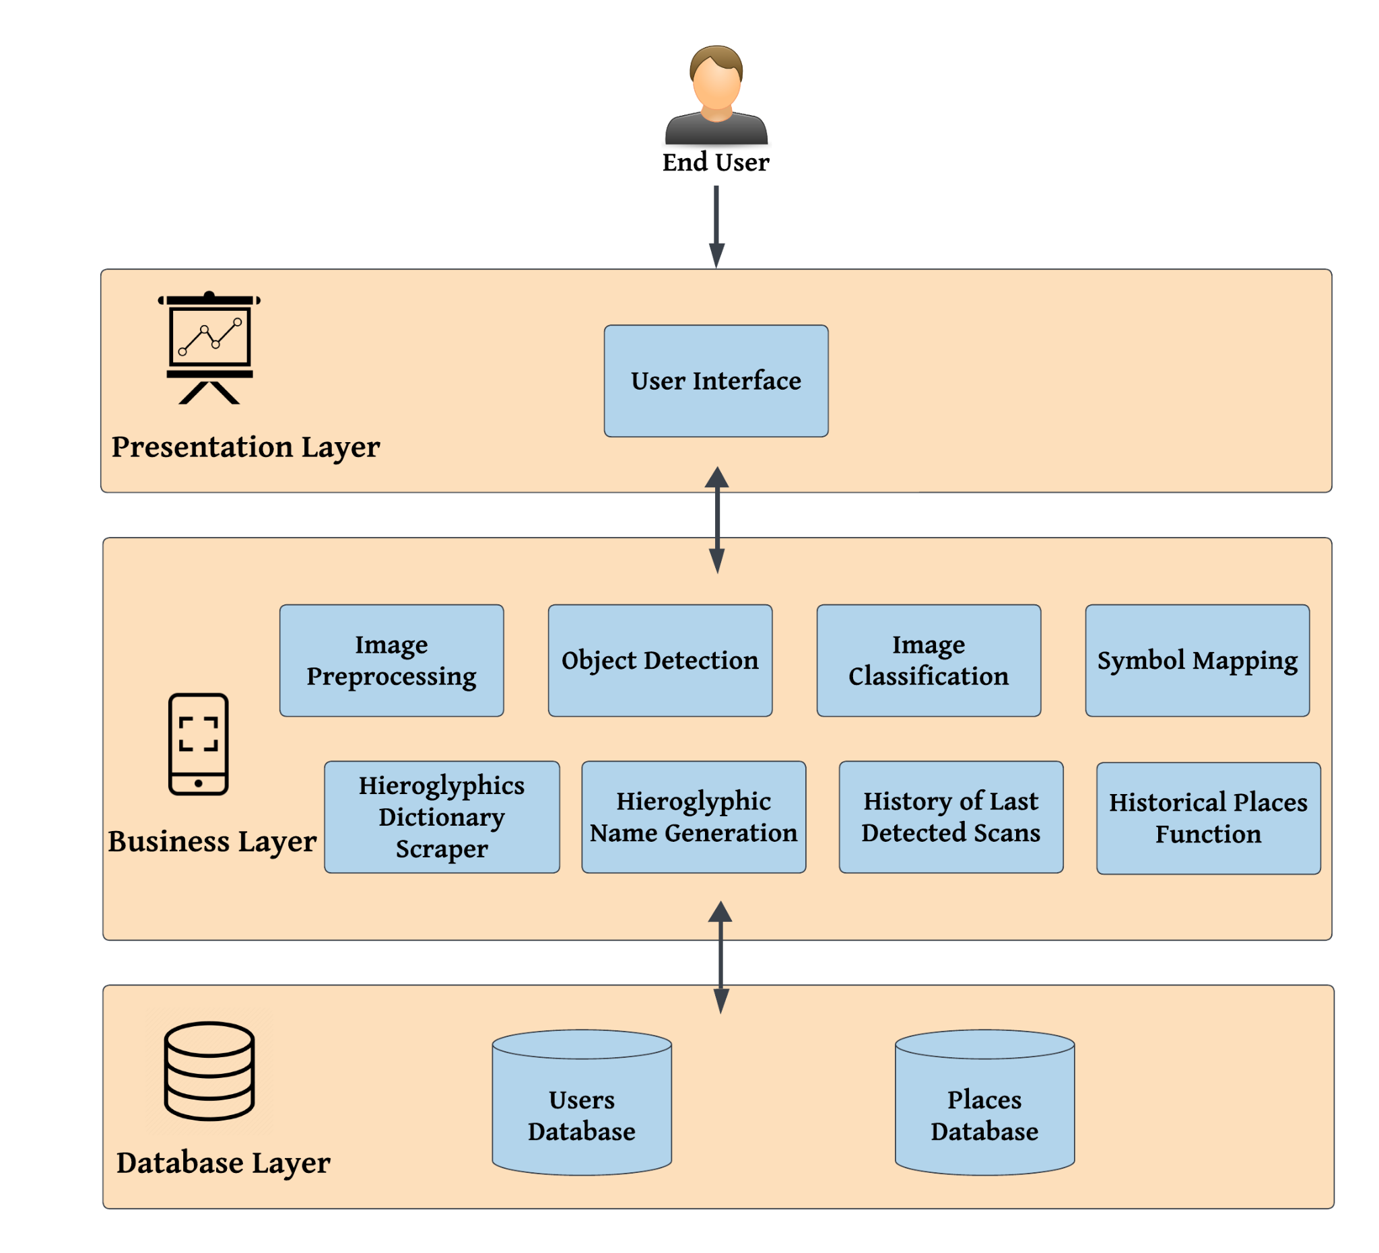

Slide 11
03
Datasets

Slide 12


Dataset Description:
Aegyptos Dataset:
Number of Classes: 1072
Scale of image : Digital
Image Size : 354x472
Problem:
One image only for each class.
Digital Dataset.
Sample of the dataset

Slide 13
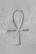
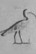
Dataset Description:
Glyph Dataset:
Number of Classes: 166
Scale of image : GrayScale (Real)
Image Size : 50x75
Problem: Imbalanced Classes.
Sample of the dataset

Slide 14
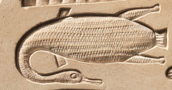
Dataset Description:
Our Extended Glyph Dataset:
Number of Classes: 166 + 97 (Collected) = 263
Scale of image: GrayScale (Real) , RGB
(Real Collected)
Image Size: Various
Problem: Imbalanced Classes.
Sample of the dataset
Notes:
Redundancy classes -> 97, 87.

Slide 15
Dataset Preparation:
1. Data Augmentation:
Horizontal flip.
Rotate (-10,10) Deg.
Brightness.
Blur.
Add Some Noise.

Slide 16

Dataset Preparation:
2. Image PreProcessing:
Resize image: 224*224
Convert RGB Images to grayscale
ToTensor: Convert image format
from raw image data to tensor
Normalize: Reduce the scale of input values, making optimization more stable.
Sample of the dataset after PreProcessing

Slide 17
Dataset Preparation YOLOv8m:
Image Annotation:
Used Roboflow annotation tool to Annotate the original Images.
Image Augmentation:
Used Previous Augmentation techniques and generate a dataset with 25,300 image with their corresponding labels, Each annotated image was augmented to create 100 variations, enhancing the diversity of the training dataset.
Labels Normalization:
Converting the coordinates of bounding boxes from their original scale (pixel values) to a normalized scale (usually between 0 and 1). This process is crucial because it ensures the model is invariant to different image sizes and scales.

Slide 18
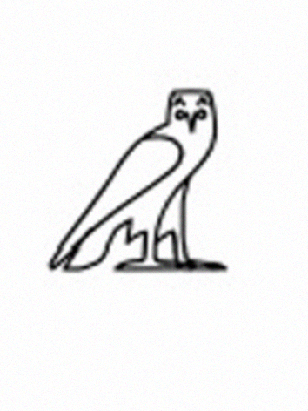
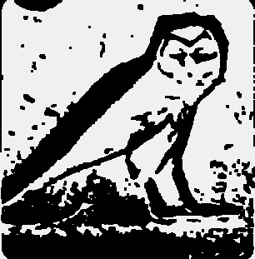


Datasets summary
Dataset | Number of classes | Dataset size Before augmentation | Dataset size After augmentation | Dataset sample image | Real input image (after pre processing)
Aegyptos | 1072 | 1072 | 1072x50= 53600
Extended Glyph | 253 | 4128 | 253*100= 25300

Slide 19
04
Models

Slide 20
YOLOv8m:
Why?
Leveraging the previous YOLO versions, the YOLOv8 model is faster and more accurate while providing a unified framework for training models for performing
Advantages:
Improved Accuracy.
Balance between model efficiency and speed of detection.
Enhanced Feature Extraction.
Workflow:
Input Image: Start with an input image.
Preprocessing: Resize and normalize the image.
Feature Extraction: Use a backbone network to extract the features.
Detection: Predict bounding boxes.
Post-Processing Finalize detection and output bounding boxes, with confidence scores.

Slide 21
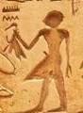
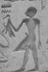


YOLOv8m:
Our goal is applying “binary object detection” through a training process on differentiation between Hieroglyphic objects and none Hieroglyphic objects
Before Preprocessing | After Preprocessing | Output
 |  | Hieroglyphic
 |  | Not Hieroglyphic

Slide 22
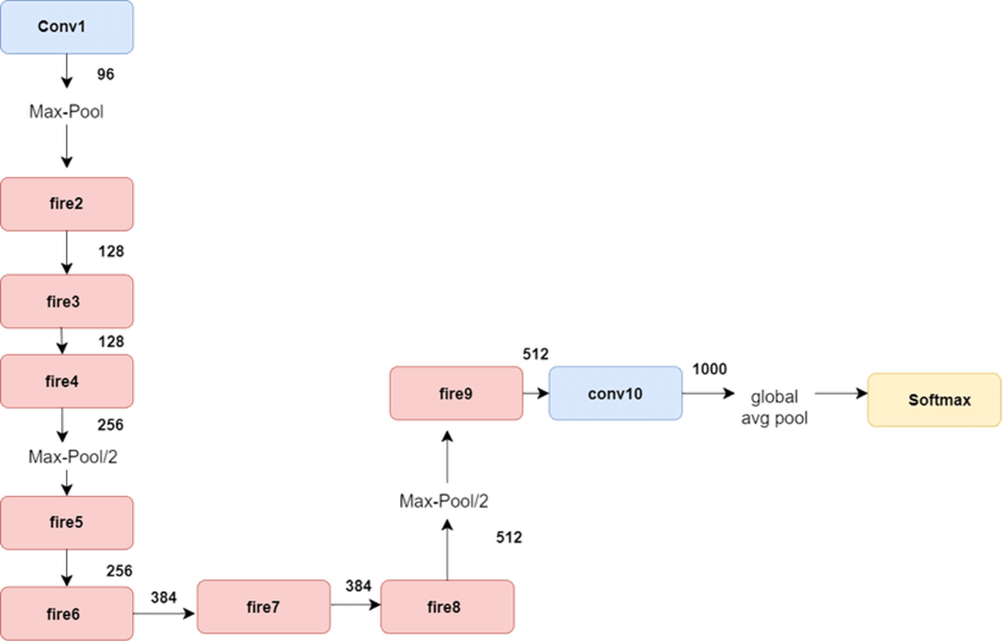
SqueezeNet:
- Total Number Of Layers: 18 layers.
- Total Number Of Parameters: 1.25 million.
Notes:
• EL RASMA 3L YEMEEN WL SHARH 3L SHEMAL • MN FIRE2 … FIRE8 • TAKTAFY BL RASMA W A3DAD EL LAYERS WL KALAM ELY HAYTSHEREH 3L SLIDE
2 (Convolutional layers)
8 (Fire modules)
2 (Max pooling layers)
1 (Global average pooling layer)
1 (Softmax layer)
4 (Fully connected layers)

Slide 23
Models:
Applied Models | Squeezenet | EfficientNet | MobileNet | Resnet50
Model Size | 1.2 million parameters | 5.3 million parameters | 3.5 million parameters | 25.6 million parameters
Performance | 96.99% | 94.09% | 90.14% | 87%
Deployment | Deployable | Deployable | Deployable | Not-Deployable
Notes:
•3ADAD EL PARAMETERS YETKTB HENA
•LAZEM YEB2A FEH ARQAM
•NEKTB DEPLOYABLE/NON-DEPLOYABLE
•EL COMPUTATION EFFICIENCY HATT2AS BL TRAINING TIME (3LA NAFS EL DATASET W 3ALA NAFS EL GEHAZ) RE-RUN ONLY ONE EPOCH FOR ALL MODELS ON ONLY ONE LAPTOP AW NSHEEL EL ROW DA
• EL PERFORMANCE HEYA EL TEST ACCURACY BTA3T KUL WAHED FEHUM

Slide 24
Models:
Applied Models On Glyph | Validation Accuracy | Test Accuracy | Epochs
Squeezenet Tuning Only Final Layer | 95.05% | 96.99% | 30
Squeezenet Tuning Through Gradual Unfreezing | 98% | 98.5% | 20
Initially, all layers except the final fully connected layer (classifier) are frozen.
Training starts with only the parameters of the classifier layer being updated.
As training progresses or as needed, more layers are gradually unfrozen “6 Layers”.
This process leverages pretrained features while adapting the model to a new task or dataset.
It helps prevent disruption of pretrained features by random weight updates during early training stages.

Slide 25
05
Results

Slide 26
Experiment 1: (Aegyptos(Digital)) Dataset Split Ratio: Train 80% And Test 20%.
Applied Models On Agyptos | Test Accuracy
ResNet50 | 95.08%
EfficientNet | 96.75%
MobileNet | 98.66%

Slide 27
Experiment 2: (Extended Glyph) Split Ratio: Train 60%, Validation 20% And Test 20%.
YOLOv8m
Metric | Value
Precision | 91%
Recall | 95%
mAP50 | 90%
mAP50-95 | 88%

Slide 28
Experiment 2: (Extended Glyph) Dataset Split Ratio:Train 60%,Validation 20%, and Test 20%.
Applied Models On Glyph | Validation Accuracy | Test Accuracy
ResNet50 | 85,61% | 87%
MobileNet | 88.21% | 90.14%
EfficientNet | 91.26% | 94.09%
Squeezenet Tuning Only Final Layer | 95.05% | 96.99%
Squeezenet Tuning Through Gradual Unfreezing | 98% | 98.5%
Notes:
•EXPERIMENT 2: EXTENDED GLYPH DATASET • NERATEB EL ROWS ML SUGHAYAR LL KBEER MSH BL 3ASHWA2YA DI

Slide 29
06
RELATED WORKS

Slide 30
Comparison with other researchers:
Reference | Method Used | Dataset | No.Classes | Performance Measure
Our Study | YOLOv8m | Extended Glyph | 253 class, 25300 Images | - Bounding-Box (mAP50) 90% (mAP50): 88%
Egyptian Hieroglyphs ‘Segmentation’ with CNNs, 2023 | Mask R-CNN | Glyph (Manually collected from Unas pyramid) | 166 class, 4210 images | - Bounding-Box Regression (mAP50) 93.4% - Mask Regression (mAP50) 91.2%
Notes:
•EXPERIMENT 2: EXTENDED GLYPH DATASET • NERATEB EL ROWS ML SUGHAYAR LL KBEER MSH BL 3ASHWA2YA DI

Slide 31
Reference | Method Used | Dataset | No.Classes | Performance Measure
Our Study | SqueezeNet | Extended Glyph | 253 class, 25300 Images | SqueezeNet (Tuning Through Gradual Unfreezing): 98.5%
Automatic Translator for Ancient Hieroglyphic Language, 2023 | Siamese | Glyph (Manually collected from Unas pyramid | 166 class, 4210 image, | Classification Accuracy: 88.5%
Hieroglyphs Language Translator using deep learning techniques (Scriba), 2022 | ShuffleNet | Glyph (Manually Collected) | 87 class | Classification Accuracy: 97.385%
Image Based Hieroglyphic Character Recognition, 2018 | Not mentioned | Glyph | 197 class, 700 images | Classification Accuracy: 66.64%
Notes:
•EXPERIMENT 2: EXTENDED GLYPH DATASET • NERATEB EL ROWS ML SUGHAYAR LL KBEER MSH BL 3ASHWA2YA DI

Slide 32
07
List of Functions

Slide 33
Functions:
Image Pre-Processing
Symbol Detection
Symbol Classification
Features:
Login/Register
Best Historical Places to use the app
Hieroglyphics Name Generator
Hieroglyphics Dictionary
History of last Detected Scans
Uploading & Scanning Symbols

Slide 34
08
SOFTWARE TOOLS

Slide 35










Slide 36
09
Demo

Slide 37
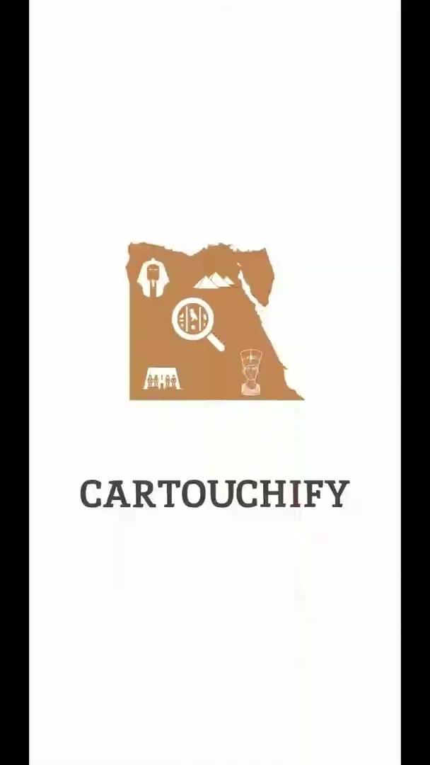

Slide 38
10
Future Work

Slide 39
Future work
Acquire a High-Quality Image Dataset.
Expand the Dataset.
Model Enhancement.
Trying to implement translation & transcription of full sentences by seeking help from domain experts.
Notes:
try to seek help from experts

Slide 40
Thank You

